Slide 1


Slide 2
PROBLEM
Price is an important concern for customers who are billed by local authorities on a monthly basis.
Local authorities fail to be transparent in their billing, leaving residents full of complaints in a way leading to poor service delivery.
No easy way exists to properly meter and present factual data that can be used in capturing water metering data.

Slide 3
SOLUTION
A web platform where users can capture and upload data for water consumption per given household.

Slide 4
MARKET VALIDATION
Bulawayo Households National Households
168K 2 million

Slide 5
MARKET SIZE
7.5 million urban 672K Serviceable 8,9% Available population(TAM) Market Market Share

Slide 6
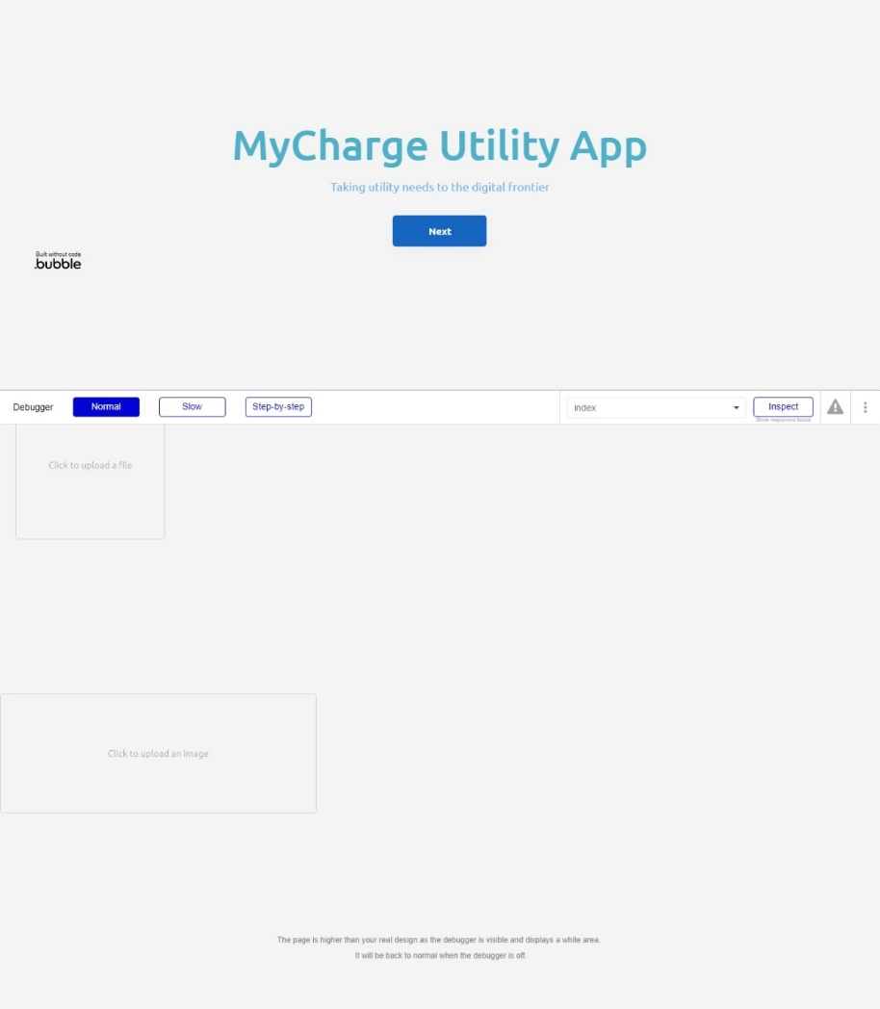
PRODUCT

Slide 7
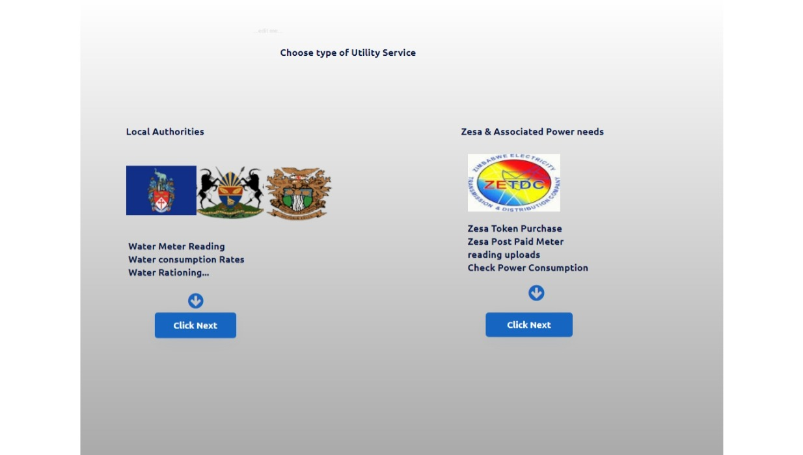
PRODUCT

Slide 8
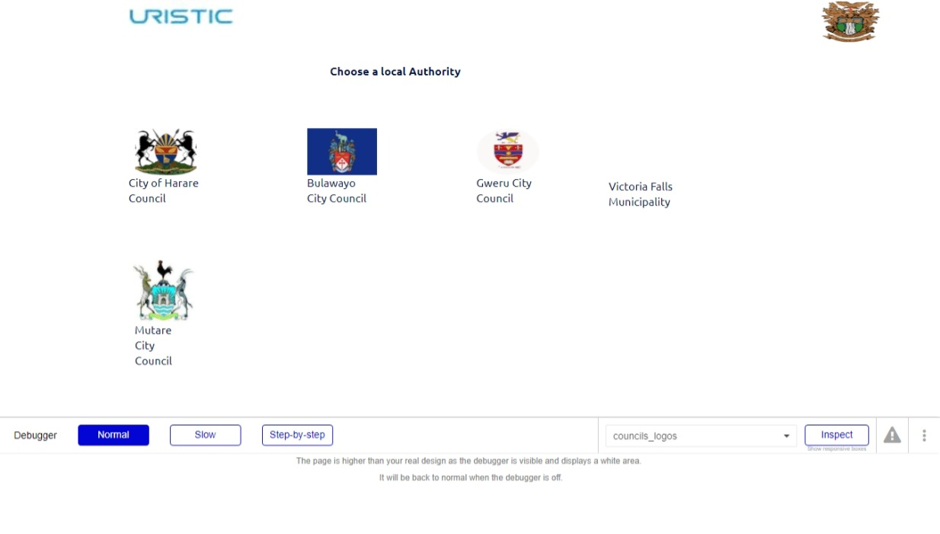
PRODUCT

Slide 9
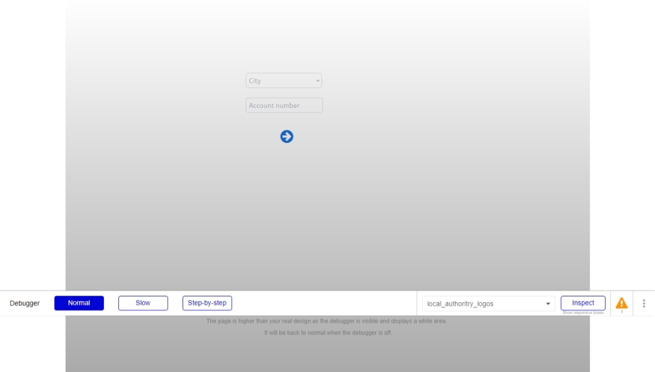
PRODUCT

Slide 10
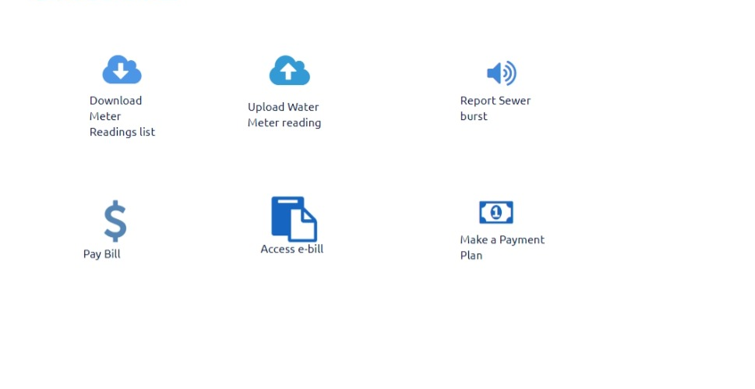
PRODUCT

Slide 11
BUSINESS MODEL
We charge a $1 per household that uses our app for water meter uploads.
168 000 Households $1/Household $2,06M
8,9% of Available Market Revenue projected for 2025

Slide 12
FINANCIAL ASK
As a start-up we are asking for funding that will push us through our trialling and product market fit stage. This period is there to fully validate and grow our user base and it shall occur within a 5 month period.
Funding shall go towards fine tuning the app, operational costs such as hosting, rent and employee remuneration. The moment we meet our targets during this period, we are going to do a follow-on fundraising round to spread our wings nationally and increase our employee headcount.
We are seeking $5000 in exchange for a 20% stake.

Slide 13
Financial
$5000 50 000 $250 000
Angel Round Bulawayo Households Revenue
Initial Investment $1 average fee Over 5 months
Opportunity

